Slide 1
Welcome to Web design 1
Yukiko Ishida

Slide 2
What will you learn?
Design and code web sites with multiple pages
Interact with the web systems that provide hosting
Move and manage files on a remote server
Analyze and discuss how web pages are created and displayed in the browser
Notes:
Designing basic sites & Working with files

Slide 3

Denai Avila

Slide 4
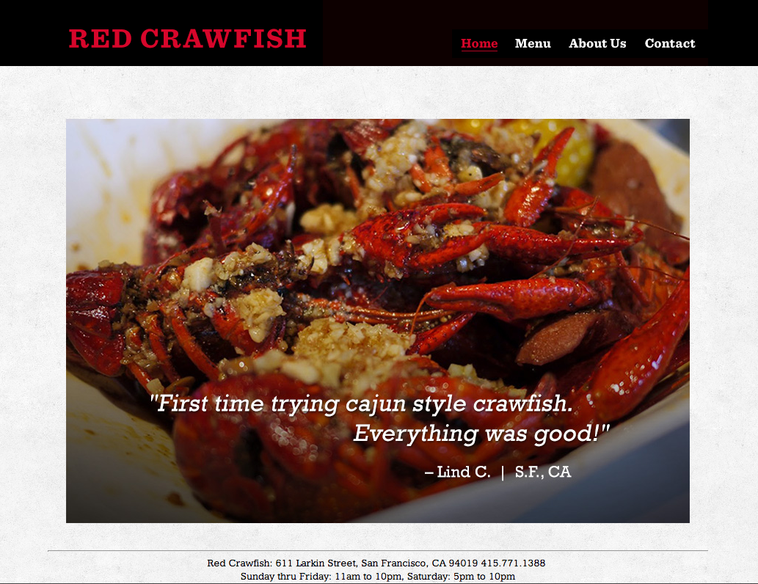
Eric Feng

Slide 5

HTML/CSS Ninjas
Write industry standard HTML and CSS
Utilize the core tags that define HTML in original web site designs
Design and code web pages using float, clear and background images
Notes:
Not focusing on software: photoshop illustrator, dreamweaver, fireworks.

Slide 6

Zihang Jiao

Slide 7

Jessica F.
Jessica F

Slide 8
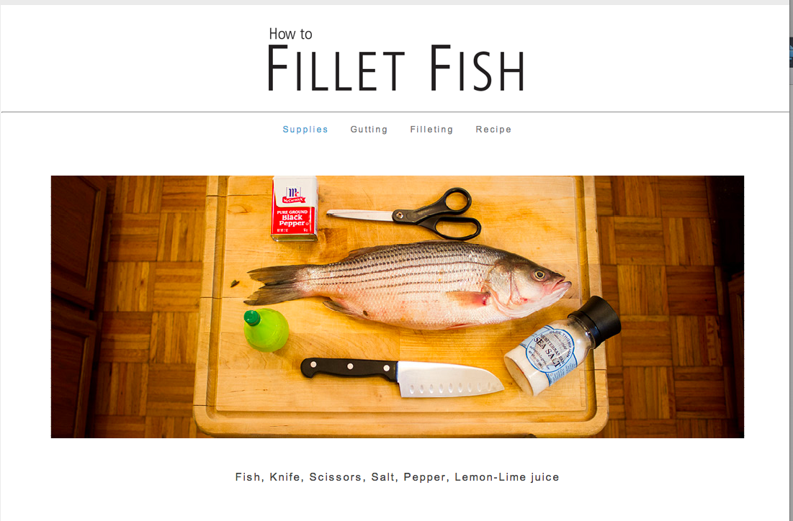
Main project: Tutorial Site

Slide 9
Supplies & tools
Code editing software (free)
FTP software (free)
Photoshop
Hosting / Domain name (~$80/yr)
Consistent internet access

Slide 10

optional
Textbook
HTML and CSS: Design and Build Websites
John Duckett

Slide 11

A step in your education
Prerequisites:
Next: Web Design 2
Design technology
Visual design principles
Responsive design
Javascript
jQuery, Dom manipulation
WEB DESIGN 3
Content management systems
CSS frameworks
Media queries
Notes:
You should have basic software skills like how to use photoshop. We’ll be reinforcing previous concepts within the area of website design. Questions, talk to me after class

Slide 12
Questions?
-- Pause --
Notes:
About content of the class?
If unsure if class is right for you, we can talk during break

Slide 13
A word of warning…
Fast paced class!
Steep learning curve
Organization & details matter
Like learning a language

Slide 14
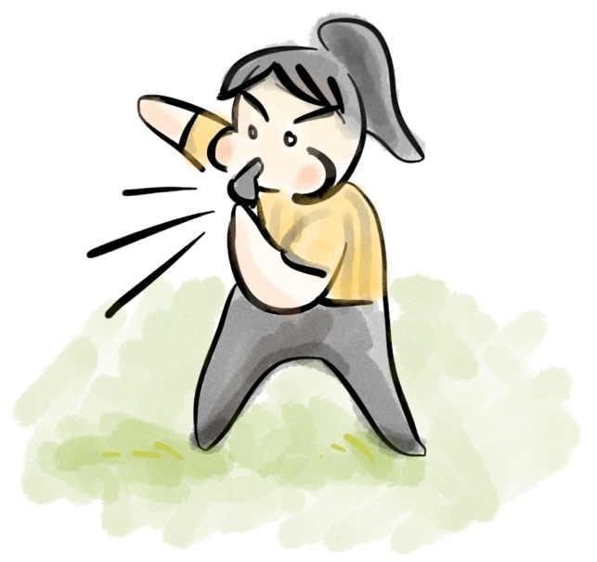
Ground Rules
Participation
Grading
Plagiarism

Slide 15
Participation
7pm - 9:50pm SHARP
~15 min break in the middle
No make-up classes, notes
All info on website
If sick/absent, homework still due
“Don't miss class, you will get behind very fast.” -DA

Slide 16
classroom
Exercises- follow along
Take notes, ask questions
Bring your files to class for work and in-progress reviews
“Do the demos alongside Yukiko in class. It's the best way to remember them. Also, troubleshooting is where you learn the most. It's not broken, it's just not done yet.” - PP
Notes:
The best way for you to learn is to practice and ask lots of questions. Help eachother learn

Slide 17
Assignments
Most due next class
Meant to practice skills
Progress on your Main Project
Style Presentation
Research project
Present and explain a visual style

Slide 18
Critiques
3 critiques
Must present for grade – no hiding!
Must participate and give feedback to others
Miss a critique, lose professionalism points
Notes:
Expectation that critique is like meeting a client. If you miss it, you don’t get paid

Slide 19
Turning in Work
Turn in work in turn-in spreadsheet via a link
Test to make sure link works!
Code uploaded to server (www.student.com)
Late assignments -20% up to 2 weeks late only! Must email assignment # to inform late submission

Slide 20
Grading is Impartial
Points for assignments/projects, add up at the end of semester
Want to see consistent progress, participation in class
No excuses! Parents, GPA, Financial aid

Slide 21
No plagiarism
You must create your own content!
Photos, illustrations
Pick assignment topic that you can create content for
Code needs to be modified substantially for own use, commented

Slide 22
Actively seek help
Ask for help in class
Email me- I am happy to respond
WNM Workshops TBD
ARC (Academy Resource Center) 1-on-1 Tutoring

Slide 23
Questions?
-- Pause --
Notes:
About content of the class?
If unsure if class is right for you, we can talk during break

Slide 24
Write this down
www.Yukikodesign.com/aau/web1
yukiko.ishida.aau@gmail.com

